Slide 1
3rd Sprint Review
Payne Moser

Slide 2
What was accomplished?
After the last sprint where I was able to find a dataset I wanted to use and I was also able to narrow my research question down. My goal for this sprint review was to import my newly found Pokemon Statistics csv file into R and use R’s graphing capabilities to compare all of the data that I wish to import.
In this sprint review I was able to successfully import the csv file using the following command in R: pokemonStats <- read.csv(file = 'pokemon.csv')
Once I was able to create a dataframe called pokemonStats I was was able create different subsets with each generation of pokemon in every generation 1-8.

Slide 3
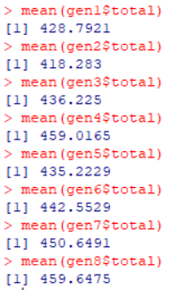
Accomplishment
Another thing that I was able to accomplish that I am especially proud of was getting the average stat total for each generation of pokemon using the mean function in R.
I wasn’t able to get these on a plot with the corresponding generation that the average stat total was for, but I am going to take a different approach and see if I am able to get them plotted correctly. When I would try to plot these values I would get the following error:

Slide 4
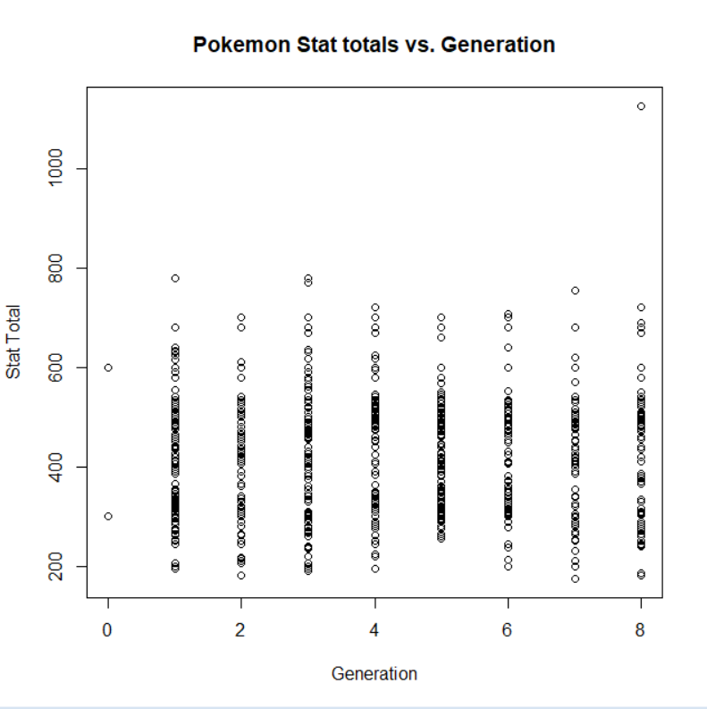
What I wasn’t able to accomplish
I was not able to graph the average stat total for each generation of Pokemon but I was able to at least use R to find it. I was able to make a graph that contains every Pokemon's stat total compared to their generation but there is just so much data on the graph that I don’t think that it would be helpful.

Slide 5
What I want to accomplish
In the next sprint review I will have graphs that are more relevant to my research question and are able to display the results that I have found so far.

